Slide 1
Academic Integrity
Avoiding Plagiarism, Citing Sources, and Submitting Original Work

Slide 2
Plagiarism
According to the student handbook:
Plagiarism is the act of taking and using the thoughts, writing, etc of another person as one’s own.
Plagiarism is a type of cheating and is punishable as such.

Slide 3
Plagiarism in Computer Science Education
Any time that you use the code of another person in your program, without their permission, whether you supply said code or are the individual taking it, it is considered plagiarism.
Using the code of another student in your program is considered plagiarism.
Copy/pasting another programmer’s code is considered plagiarism.

Slide 4
Consequences of Plagiarism
Anyone who is caught plagiarizing can face the following consequences:
Student Repercussions- Your Student Handbook outlines the schools’ consequences for cheating/plagiarism on page 24-25.
Professional Repercussions - You may be fired from your job and employers may not want to hire you.
Legal Repercussions - The original author of the work can pursue monetary reparations for the theft of their work.
http://www.ithenticate.com/resources/6-consequences-of-plagiarism

Slide 5
How to Avoid Plagiarism
Submit your own work!
If you are allowed to search for resources, consult another programmer, or use parts of another programmer’s code, you have to cite the source and give credit to the original author.

Slide 6
Citing Work in Computer Science
In the rare case that you are allowed to use parts of another programmer’s code, you must cite them as a resource inside the code itself.
Your citation should be included in the header of your program.

Slide 7
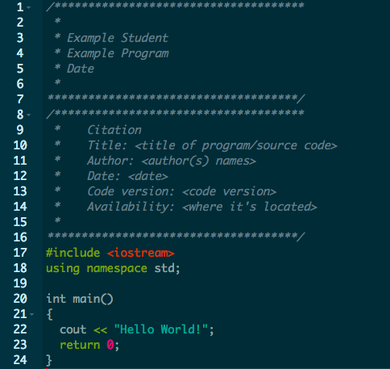
Example Citation
http://uark.libguides.com/CSCE/CitingCode

